Slide 1

BE THE FORCE FOR GOOD-LOCALLY AND GLOBALLY

Slide 2
INTRODUCTION TO CLOUD COMPUTING
ROHAN RAJ

Slide 3


What is Cloud?

Slide 4
Cloud Computing Services
Compute power - such as Linux servers or web applications
Storage - such as files and databases
Networking - such as secure connections between the cloud provider and your company
Analytics - such as visualizing telemetry and performance data

Slide 5
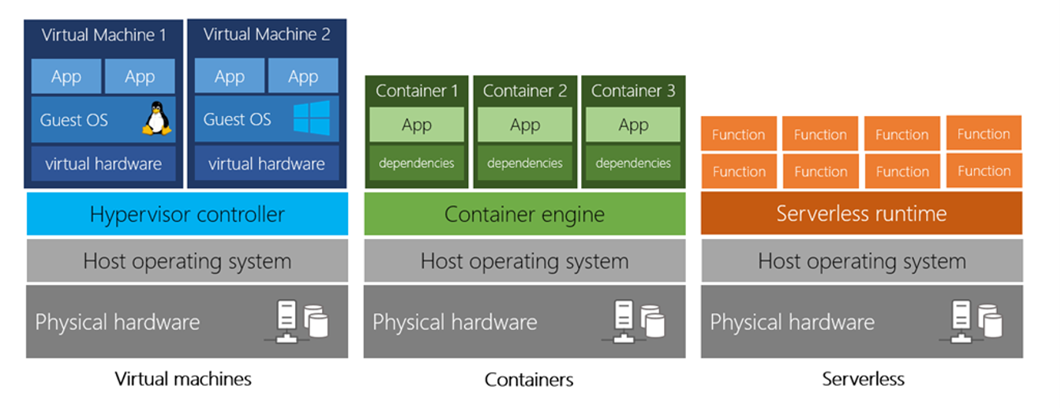

Slide 6
Benefits of Cloud Computing
It’s Cost Effective
It’s Scalable
It’s Elastic
It’s Current
It’s Reliable
It’s Global
It’s Secure

Slide 7
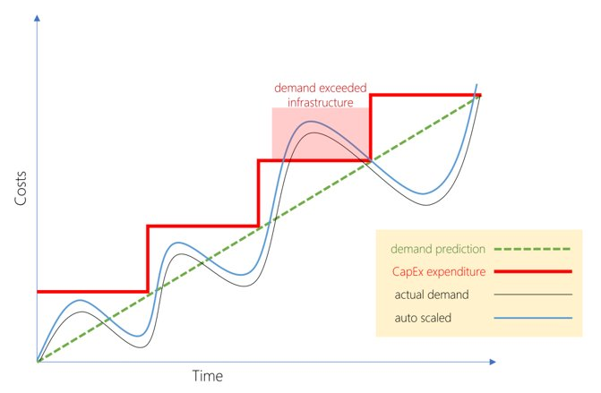
Capital expenditure (CapEx) versus Operational expenditure (OpEx)

Slide 8



Cloud deployment models
PUBLIC CLOUD
PRIVATE CLOUD
HYBRID CLOUD

Slide 9

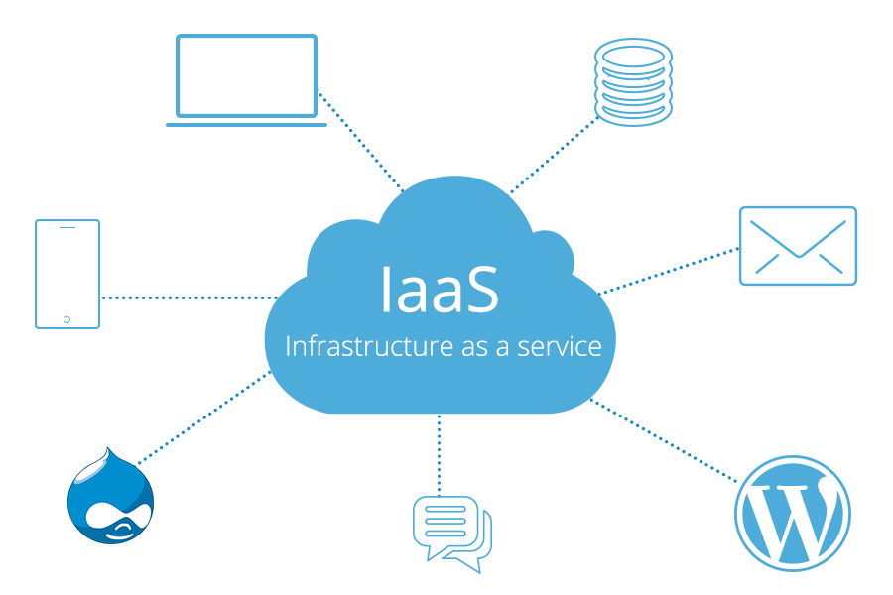


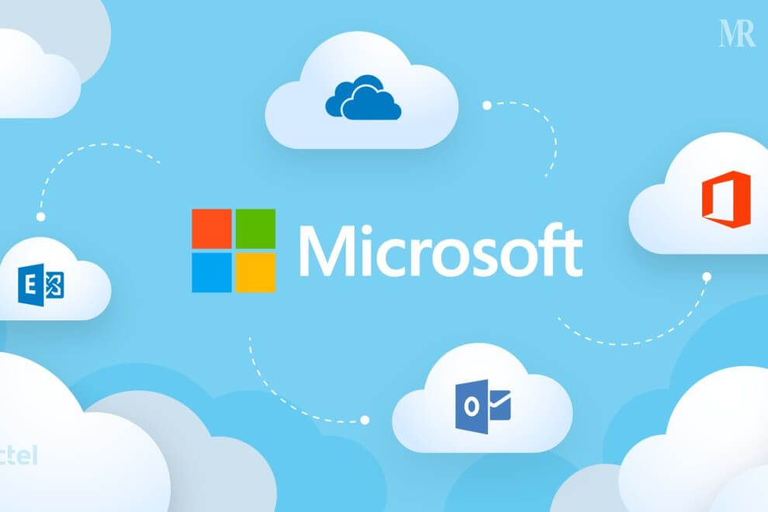
TYPES OF CLOUD SERVICES
INFRASTRUCTURE AS A SERVICE
PLATFROM AS A SERVICE
SOFTWARE AS A SERVICE

Slide 10
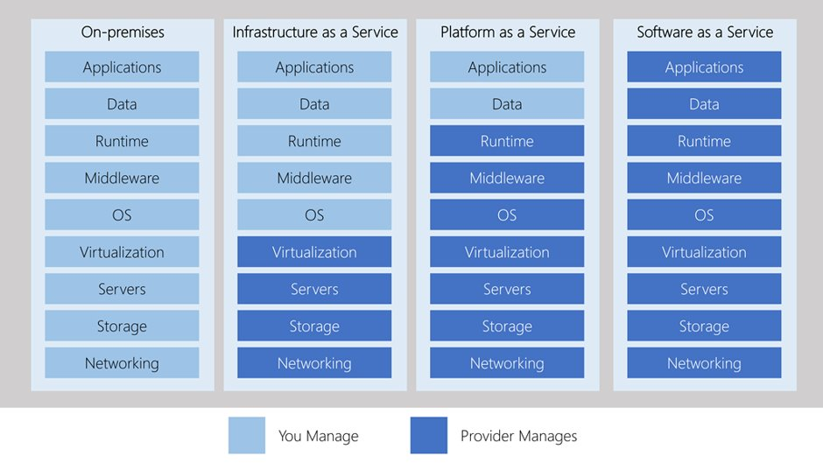

Slide 11
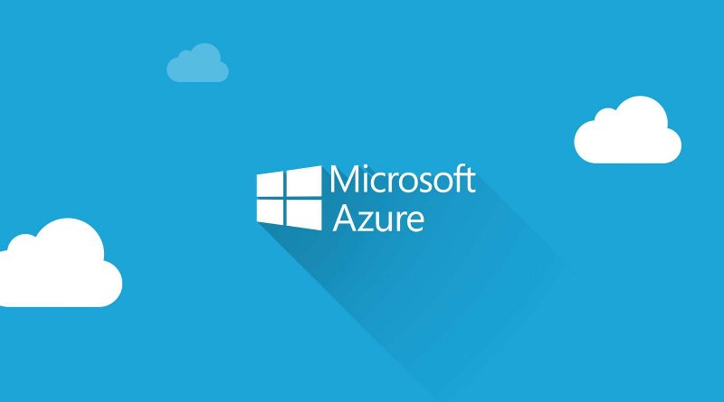

Slide 12
HOW DOES AZURE WORK?

Slide 13
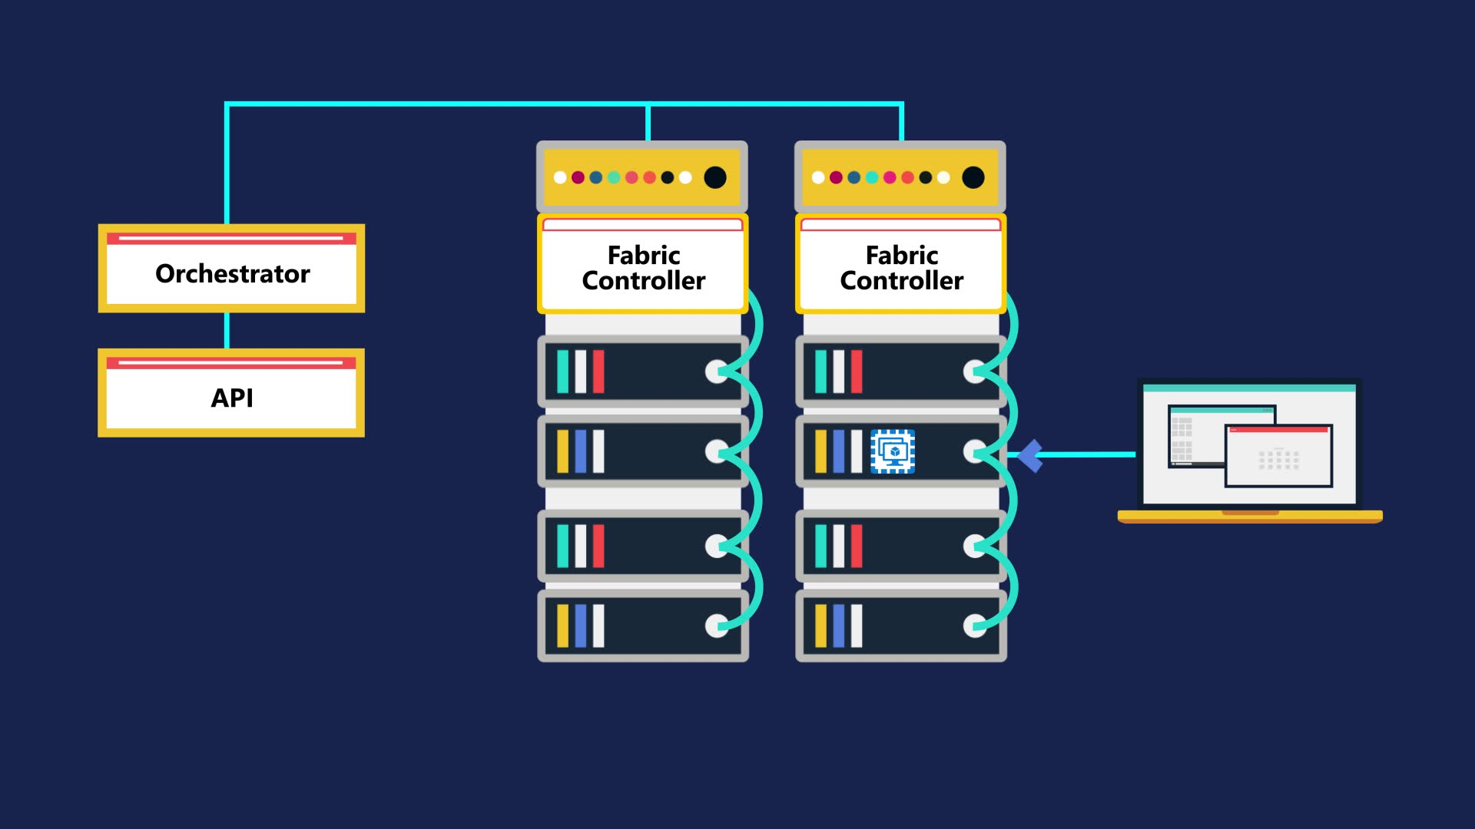

Slide 14

Learn more about Cloud on MS Docs: https://docs.microsoft.com/en-gb/learn/paths/azure-fundamentals/

